Slide 1
4.1

Slide 2
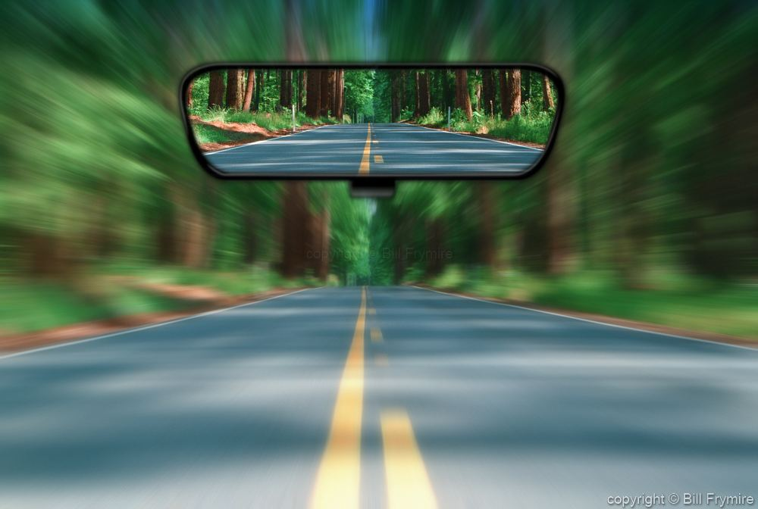
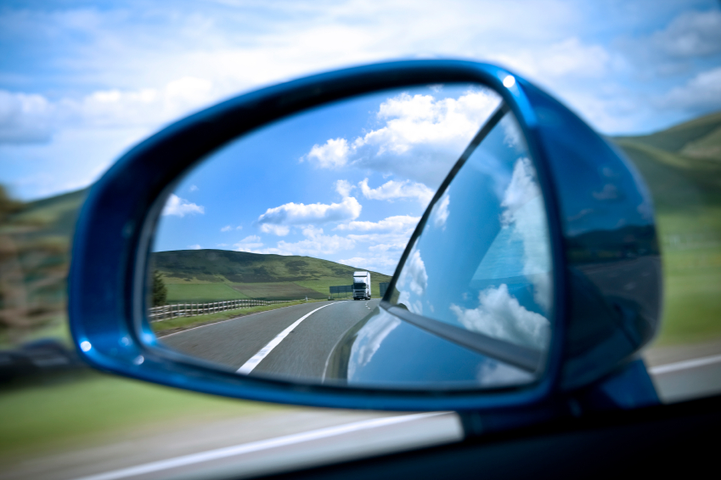
There are three mirrors that come as standard equipment on most vehicles:
the inside rearview mirror
two outside mirrors

Slide 3
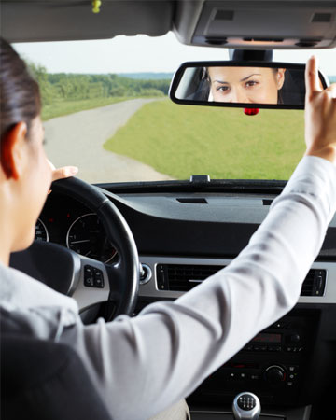
Rearview Mirror
Check and adjust the rearview mirror before you start your car
Check before and after making a turn at an intersection.
Check before and after passing another vehicle.
Check the mirror before and after making a lane change.
Make multiple quick checks

Slide 4
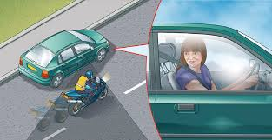
Outside Mirror
Before moving the vehicle to either side, check the outside mirror on the side to which you will be moving.
look over your shoulder in the direction you wish to move to check your blind spot

Slide 5
Convex Mirror
The surface of a convex mirror is curved outward like the exterior of a ball, which allows a wider view of the area to the side and rear of the vehicle.

Slide 6
Scanning
Develop the art of scanning:
Glance continually and quickly through your orderly visual search pattern.
Look and see as you scan, but do not stare at any one event or clue.

Slide 7
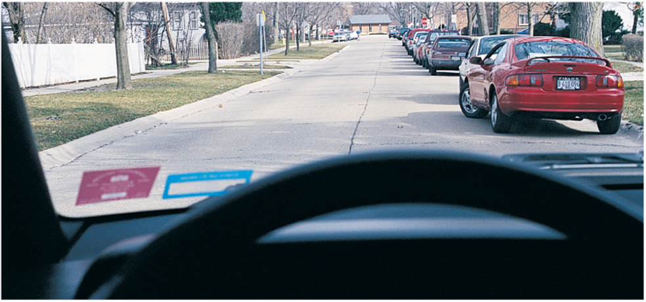
Look for clues as you scan
What clues do you have that the parked red car might pull out and close your zone?

Slide 8
Backing
Before entering the car, always walk to the rear of the vehicle before getting into it to check for a safe path for the tires to travel.
Place your foot firmly on the brake, and shift into REVERSE.
Use a target to aim the car toward. Look over your right shoulder to see your targeting path.
Check all three mirrors in addition to looking over your shoulder.
Travel no faster than a crawl by slightly releasing brake-pedal pressure.

Slide 9
Reversing
Backing Straight
Check your mirrors
Scan 360 degrees
When backing straight, put your left hand on the steering wheel at the 12:00 position.
Do not need to move the steering too much
Backing Left or Right
Check your mirrors
Scan 360 degrees
When backing left or right, start with both hands on the wheel.
Pull the wheel from the top down in the direction you want the back of the vehicle to go.

Slide 10
4:15-
https://www.youtube.com/watch?v=HsLCyGc6dg8

Slide 11
4.2

Slide 13
Position your vehicle in the correct lane for the turn
Brake early to reduce speed.
Search the left, front, and right zones.
Slow to about 10 mph just before the crosswalk.
Begin turning the wheel when your vehicle’s front bumper is even with the curb line.
Turn your head and steering wheel toward the target area once the car enters the intersection.
Halfway through the turn, while looking to the target area, accelerate as you turn your steering wheel to be on target.

Slide 14
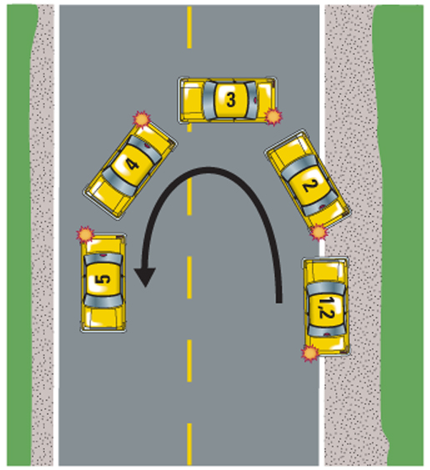
Midblock U-turn
Do not make a U-turn on a one way street.
Only make a U-turn when it is clear.
Pull to the far right edge of the road and stop.
Check the front and back, and your left-rear blind spot. If clear, signal and turn sharply left while moving slowly.
When the vehicle is headed toward your target area, recheck your rear and accelerate to the speed of traffic.

Slide 15
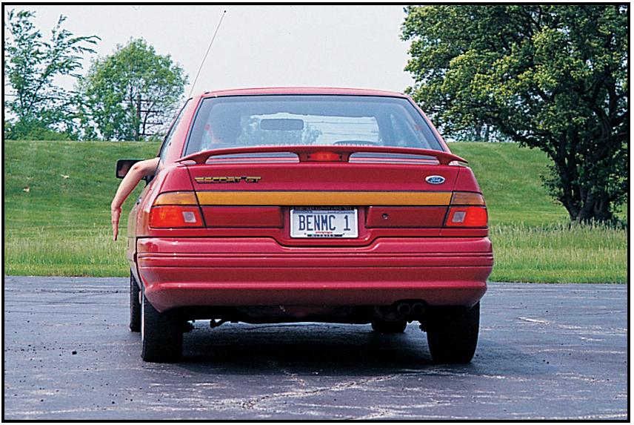
The most common method of communicating your intentions on the road is by the turn-signal lights.
Signal every time you plan to turn, change lanes, pull to the side, or re-enter the traffic flow.
Right Turn
Slowing down or stop
Left Turn

Slide 16
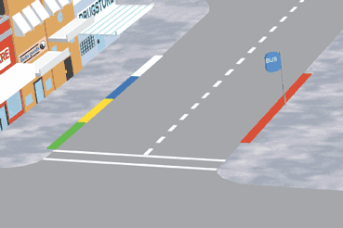
Parking at Colored Curbs
Red – No stopping or parking
Blue – Parking is permitted only for a disabled person
White – Stop only long enough to pick up or drop off passengers
Green – Park for a limited time
Yellow – Stop no longer than the time posted to load or unload passengers

Slide 17
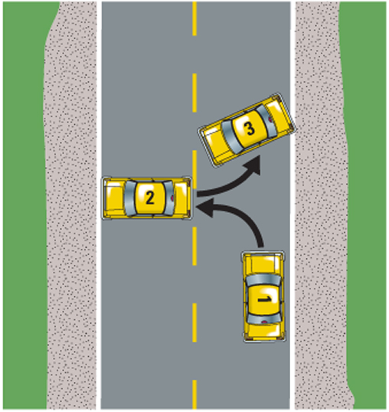
Three-Point Turnabout
Should only be performed where there will be no traffic.
Pull as far to the right side of the road as you can. Check in front and behind. Make a blind-spot check and signal for a left turn.
If your path is clear, turn sharply left and stop before reaching the curb.
Recheck for traffic, shift to REVERSE, and turn sharply while backing slowly. Back only as far as necessary to complete the maneuver.
Check traffic again and signal left. Move slowly forward while steering toward your new target area.

Slide 18
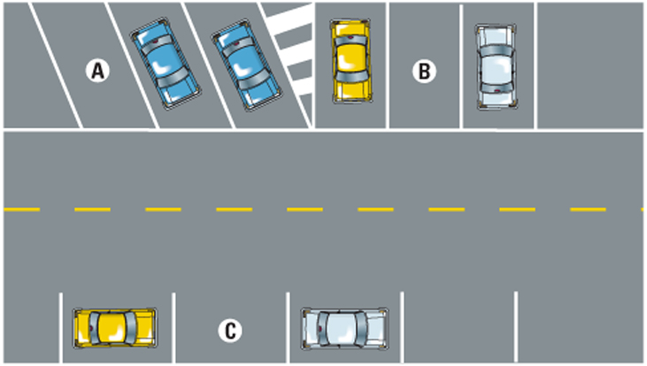
Three basic ways to park:
A. Angle Parking spaces can be at the curb of a street or in a parking lot.
B. Perpendicular Parking is only used in parking lots.
C. Parallel Parking is a method of backing between two vehicles that are parked alongside a curb.

Slide 19
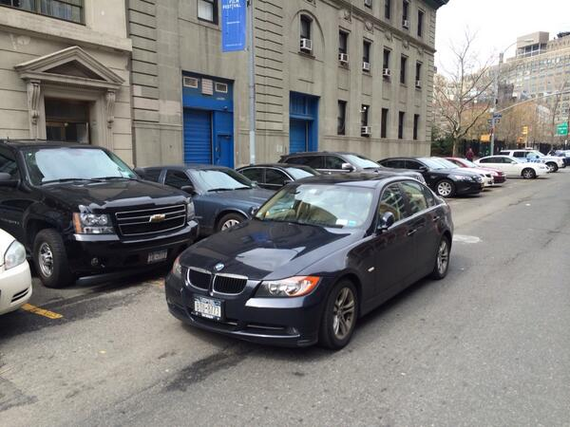
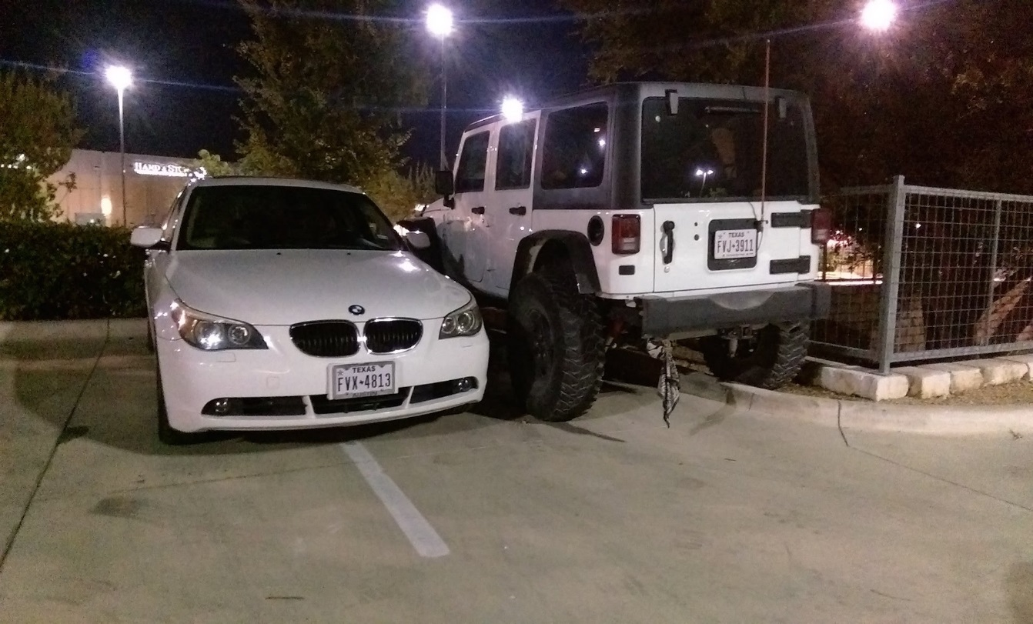
YOU MAY NOT DOUBLE PARK!
Parking parallel to a car already parked at the curb, double parking in a single spot

Slide 20
4.3

Slide 21
Reference Points
A reference point is some part of the outside or inside of the vehicle, as viewed from the driver’s seat, that relates to a part of the roadway.
The reference points on a vehicle that are typical for most drivers are called standard reference points.
A personal reference point is an adaptation of a standard reference point for your own vehicle.
The forward reference point is when steering should begin during a maneuver.

Slide 22
Parallel Parking
Right way to Parallel Park
https://www.youtube.com/watch?v=TMrO_-bsooQ
Wrong way to Parallel Park
https://www.youtube.com/watch?v=vRgG_W-6aR4

Slide 23
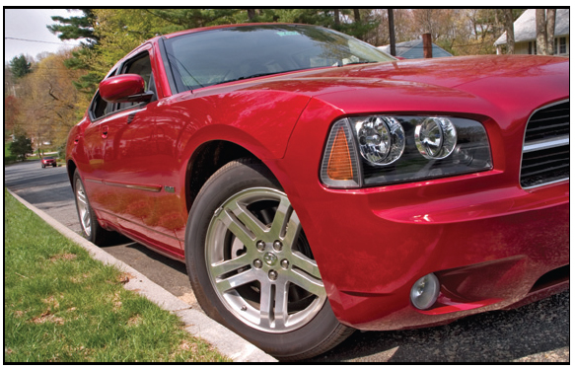
Parking on Hills
When parking uphill against a curb, turn the front wheels to the left.

Slide 24
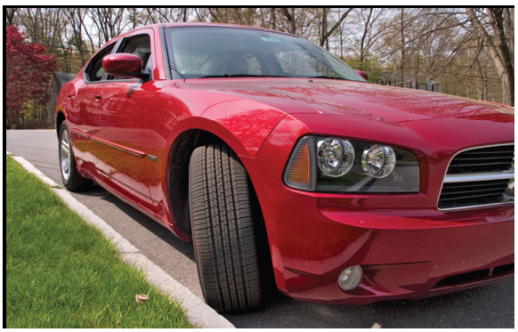
When parking downhill against a curb, turn the front wheels to the right.

Slide 25
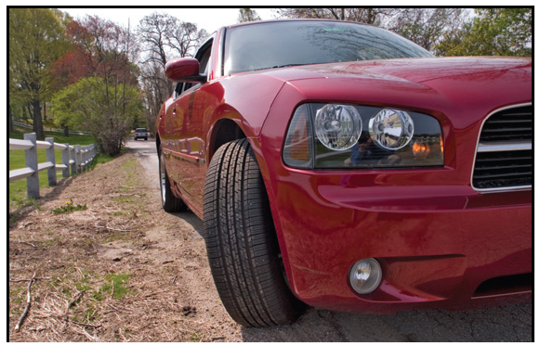
When parking uphill or downhill where there is no curb, turn your wheels to the right.

Slide 26
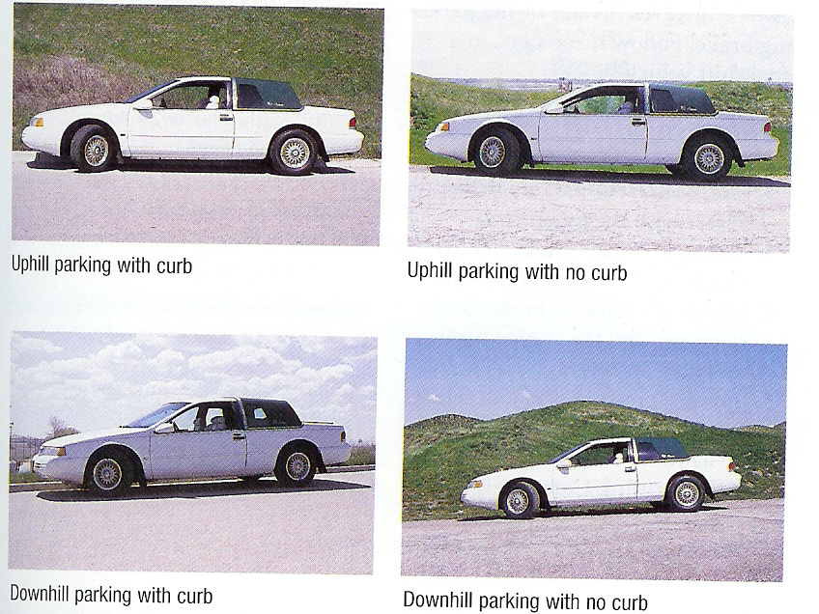
Parking on Hills
Notes:
Up on a hill – left

