Slide 1
How to check for your assignments

Slide 2
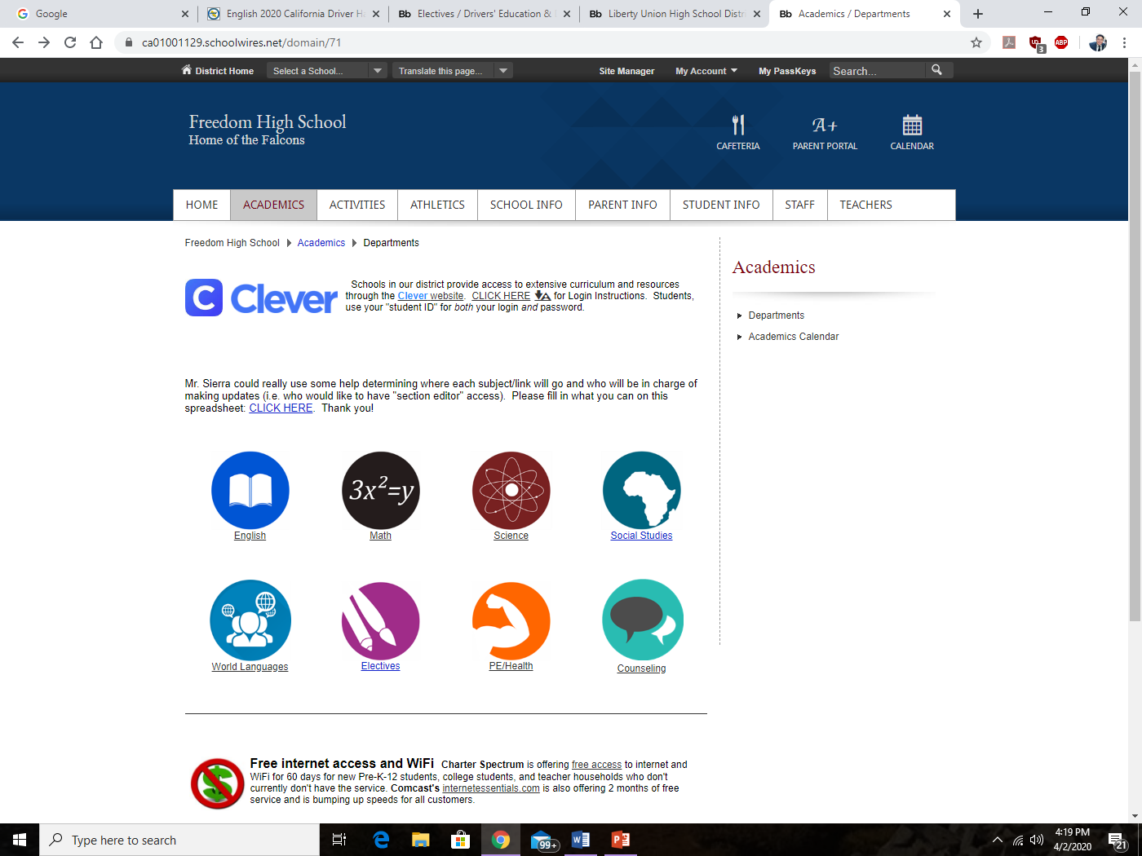
1st Go to Freedom High School’s webpage
2nd Click on the “Academics” tab

Slide 3
3rd Click on the “Social Studies” Link

Slide 4
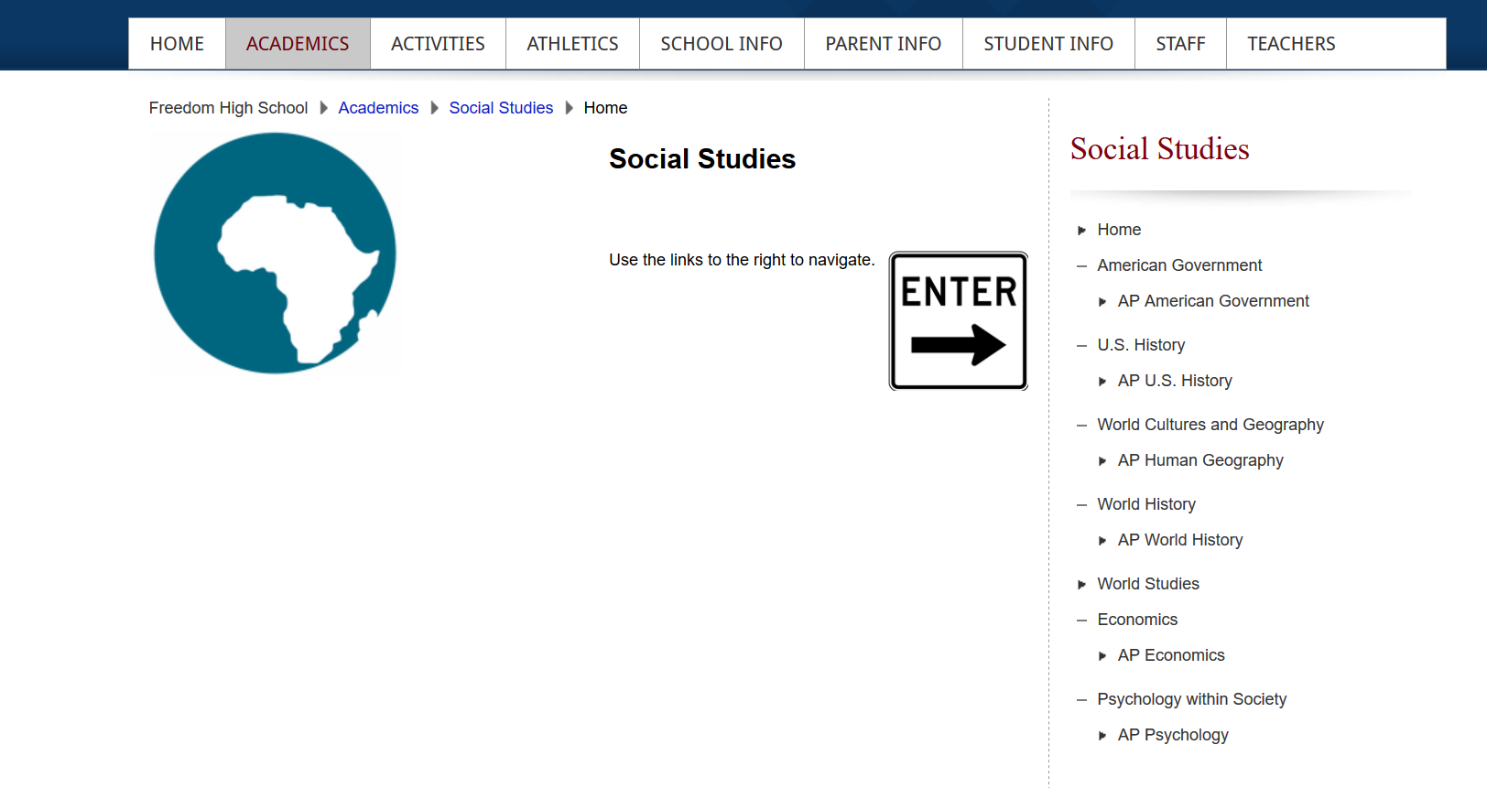
4th Click on World history

Slide 5
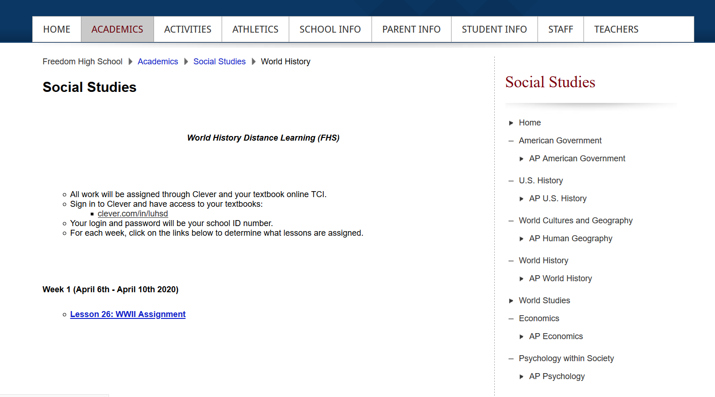
5th Click on and view your assignments and their due dates for the week

Slide 6
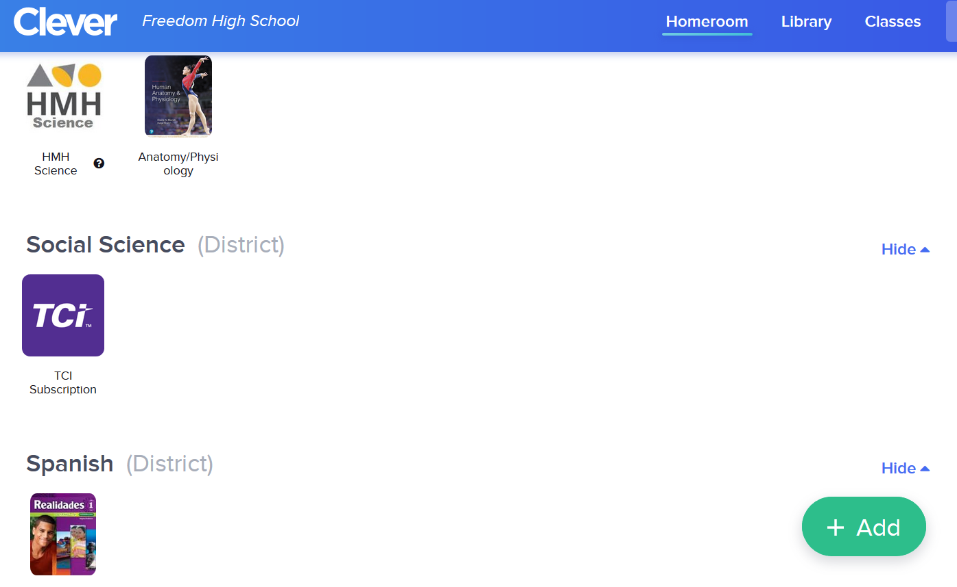
6th –Go to Clever.com and log in using your School ID for both username and Password.
7th -Click on the Social Science Link “TCi”

Slide 7
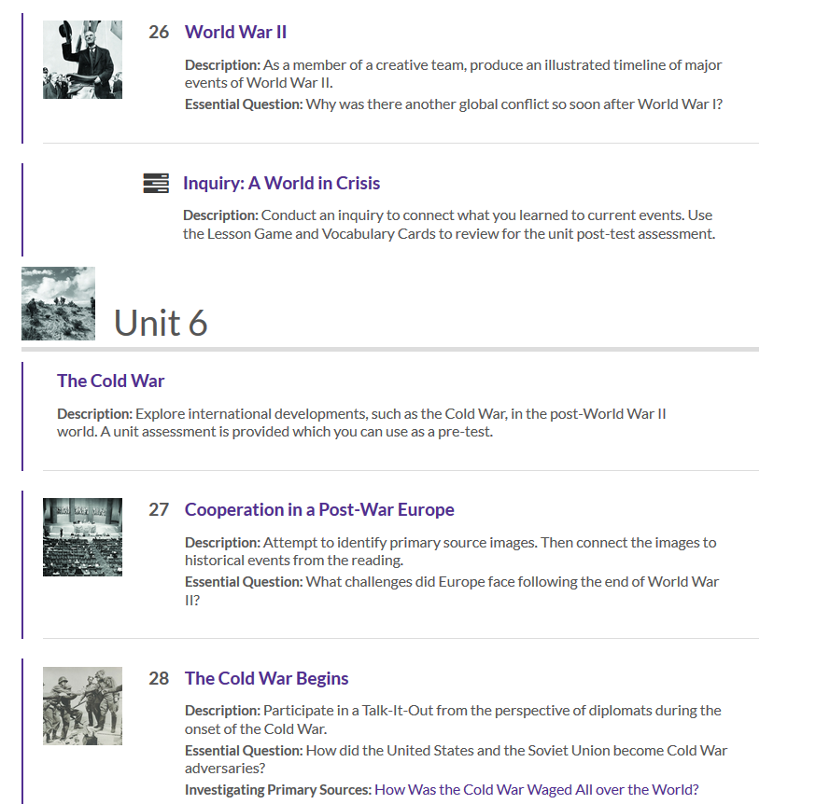
8^{th -} Click on the assigned Chapter and complete all assignments for the week

