Slide 2
Journal Question
What feelings does this video elicit? What words go through your mind?

Slide 3
Development of the A-Bomb
Leo Szilard
Jewish Hungarian physicist
Lived in Berlin, Germany
Escaped Nazis in 1933
Conceived the mechanism of the nuclear chain reaction while on a walk in London in 1933

Slide 4
Nuclear Chain Reaction
Sketch from patent
Szilard patents his idea in 1936 to keep it a secret
He doesn’t yet know the element that will make the chain reaction possible
In 1938 German physicists discover nuclear fission (the process for generating nuclear energy)
They begin Uranvereins, the German nuclear program
During WWII, German physics proves to be not as advanced as the Allies’
The Nazis decide to slow down their program in 1942

Slide 5
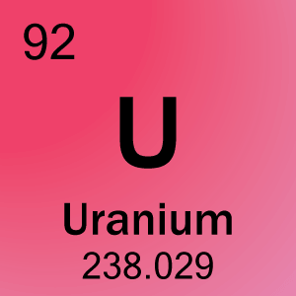
Szilard’s Experiments
In 1939, Szilard, now living in New York, hears about the German physicists’ discovery of a chain reaction utilizing uranium
He is concerned they will build a nuclear weapon
Szilard conducts his own experiments of a nuclear chain reaction using uranium at Columbia University
Uranium is a very heavy metal which can be used as an abundant source of concentrated energy
"That night, there was very little doubt in my mind that the world was headed for grief.”

Slide 6
Letter to FDR
Szilard and Einstein
Szilard fears that Nazi Germany will develop, and use, an atomic bomb
Germany begins a nuclear program in 1938
Szilard and Albert Einstein write a letter to President Roosevelt warning that Nazi Germany will try to develop a nuclear weapon.
They argue that Germany is trying to build a nuclear bomb

Slide 7
FDR Responds
FDR creates the Committee on Uranium in 1939
This committee evolves into the Manhattan Project by 1941
The goal of the Project is to create an atomic bomb

Slide 8
Manhattan Project
FDR appoints General Leslie Groves to direct the Manhattan Project
The Manhattan Project is based at Los Alamos National Laboratory in New Mexico
Oppenheimer is the lead physicist and director at Los Alamos
J. Robert Oppenheimer

Slide 9
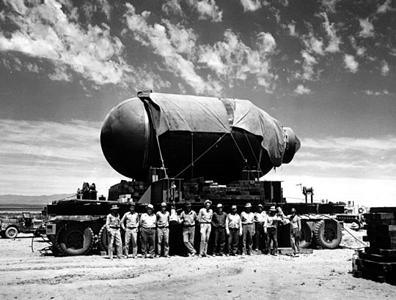
First Nuclear Bomb
FDR dies April 12, 1945
Germany surrenders May 7, 1945, War in Pacific continues
The Manhattan Project successfully builds 3 nuclear bombs
They detonate the first, codenamed Trinity, in New Mexico on July 16, 1945
Trinity test, .025 seconds after explosion

Slide 10
Potsdam Declaration – Prompt and Utter Destruction
Leaders of the Allied countries meet in Potsdam, Germany
On July 26, 1945, USA, Britain, and China issue joint declaration promising “prompt and utter destruction” if Japan does not surrender immediately
Does not mention atomic bombs
Japan refuses to surrender

Slide 11
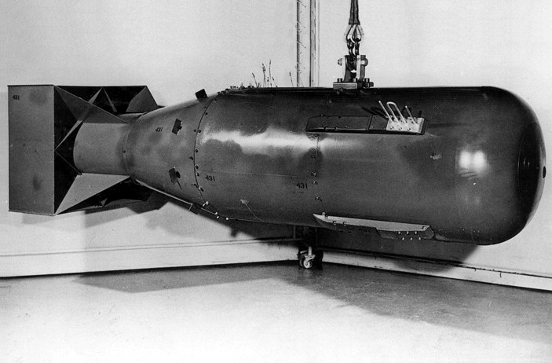
Hiroshima
On August 6, the bomb codenamed “Little Boy” is dropped on Hiroshima

Slide 12
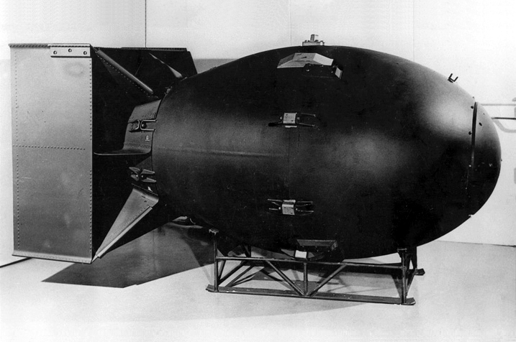
Nagasaki
On August 9, the bomb codenamed “Fat Man” is dropped on Nagasaki
Primary target was Kokura, but smoke from American firebombs and clouds led to poor visibility

Slide 13
Japan Surrenders
The following day, Japan agrees to surrender according to the terms of the Potsdam Declaration, ending WWII

