Slide 1
How to check for your assignments

Slide 2
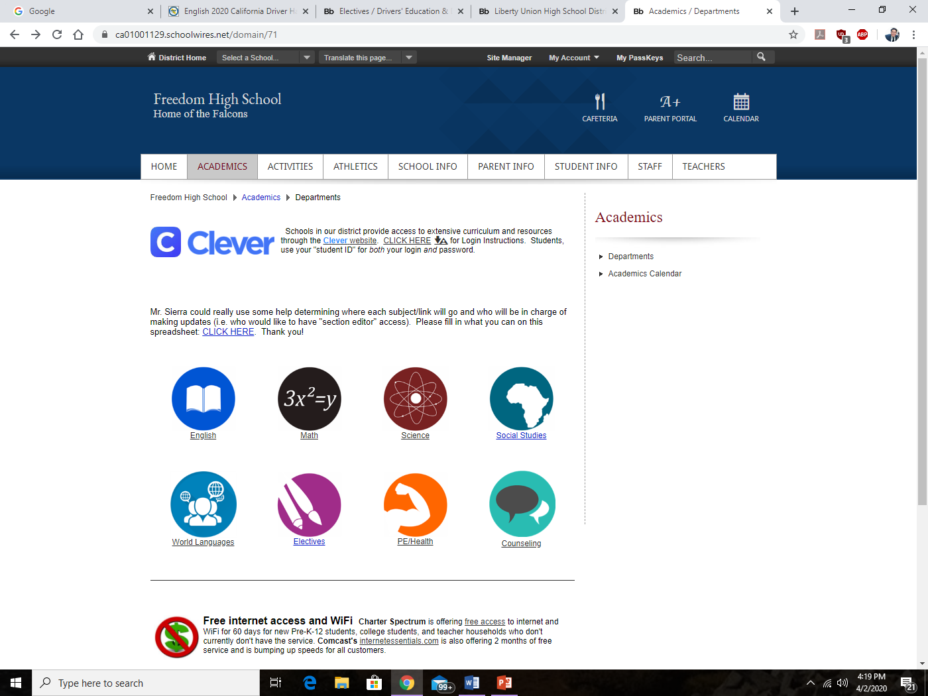
1st Go to Freedom High School’s webpage
2nd Click on the “Academics” tab

Slide 3
3rd Click on the “Electives Page”

Slide 4
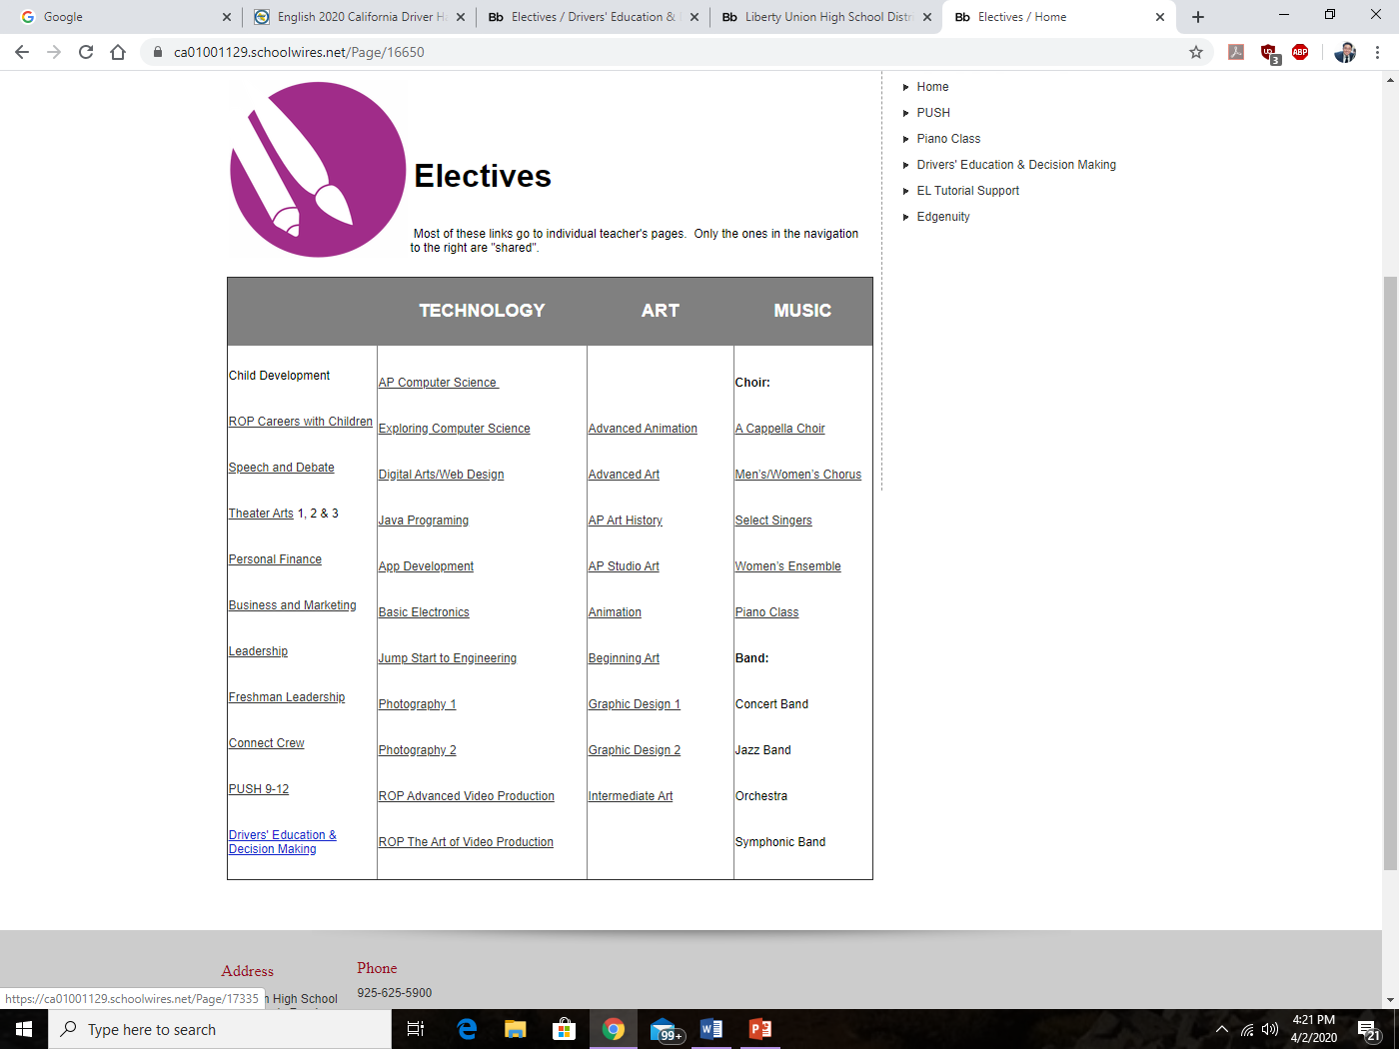
4th Click on “Drivers’ Education & Decision Making”

Slide 5
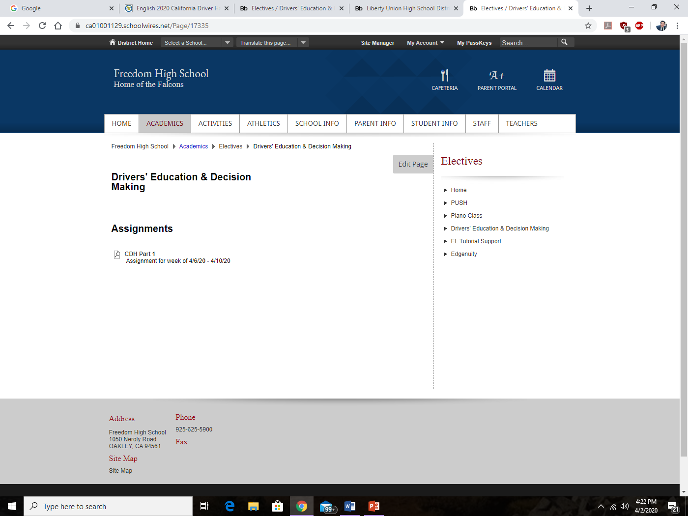
5th Check for your assignments and their due dates for the week

