Slide 1
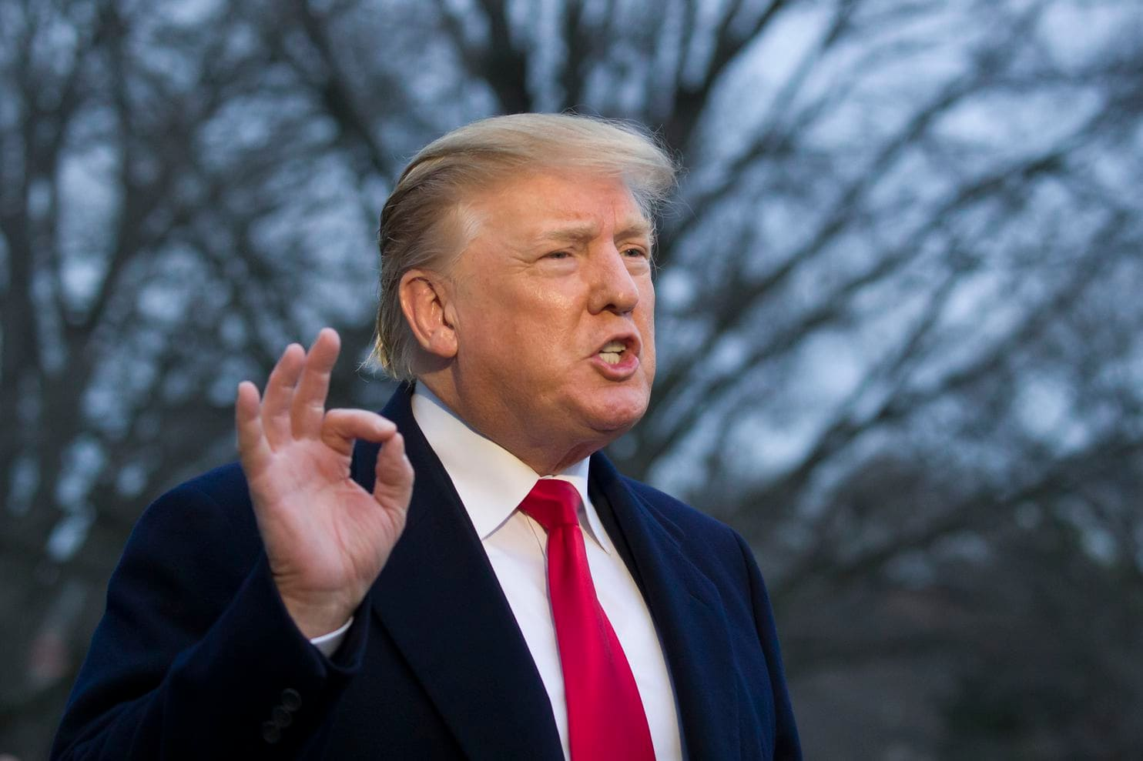
Journal #21 Should the President be impeached?
Impeach – Formally charge the holder of a public office with criminal misconduct
Could be compared to a grand jury bringing charges against a civilian
Different from a conviction that would remove the President from office

Slide 2
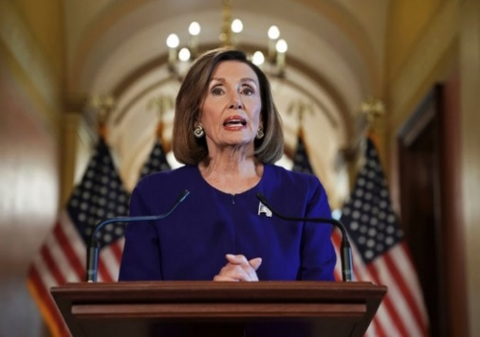
3 Stages of Impeachment
House of Representatives Votes whether to impeach
Congress Investigates
Senate votes whether to Remove from Office
When the formal charges are brought before the 435 Members of the House of Representatives, the House will vote on whether to Impeach the President.
The House vote requires a simple majority (50% +1) to impeach
Democrats have House majority
Impeachment doesn’t remove the President from Office
Andrew Johnson in 1868 and Bill Clinton in 1999 are the only 2 Presidents to have been impeached. Neither was removed from office. Richard Nixon resigned in 1974.
Once the President has formally been impeached, the 100 Senators conduct a trial on whether to convict and remove from Office the President
It requires a 2/3 vote
67 out of 100 Senators must vote to convict
Currently the Senate is split with 53 Republicans and 47 Democrats or Independents
Nancy Pelosi, the Majority Leader of the U.S. House of Representatives, has announced that Congress will oversee an investigation about President Trump’s contact with the government of the Ukraine to decide whether or not it warrants a formal criminal charge.
Crimes that might warrant impeachment include Treason, Bribery, or other “high Crimes and Misdemeanors” according the U.S. Constitution
Nancy Pelosi announces the investigation about whether the House will file articles of impeachment on September 24, 2019

Slide 3
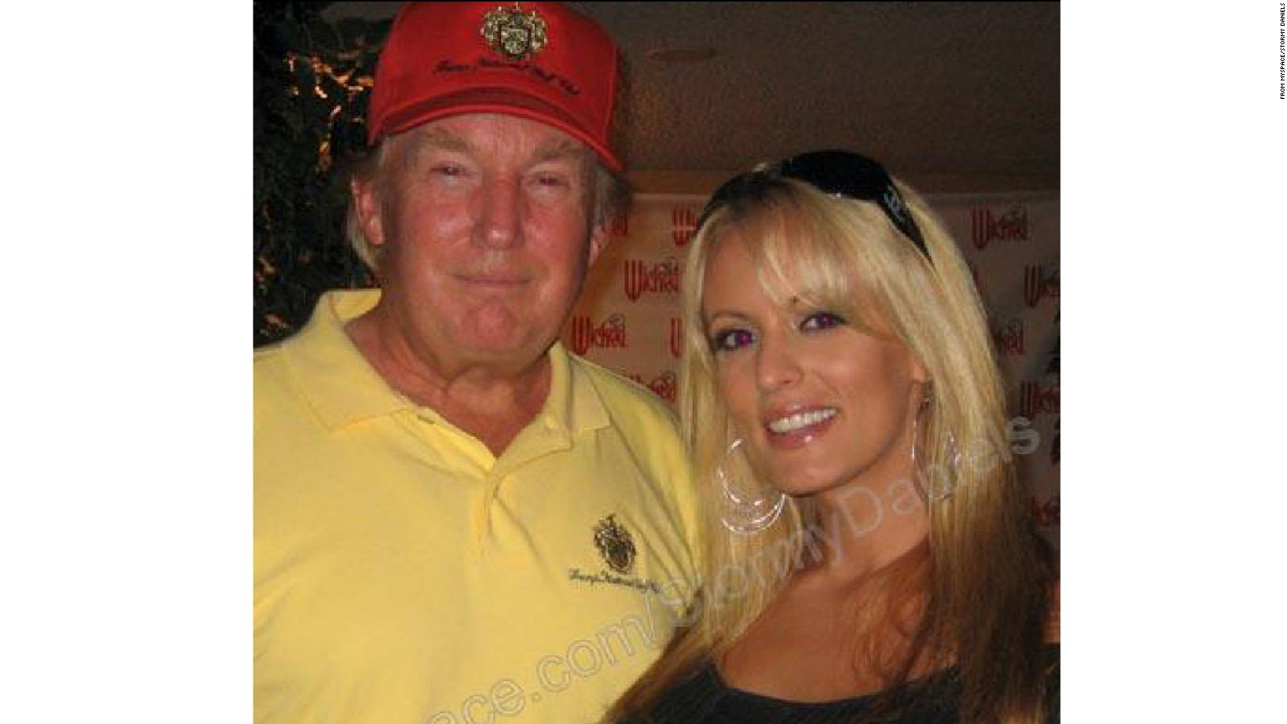
How We Got Here
President Trump made a secret settlement that included a non-disclosure agreement with porn actress Stormy Daniels that she could not speak of their affair
24 women have accused President Trump of sexual misconduct
Many of President Trump’s campaign managers, friends, associates, and members of his administration have been convicted of various crimes
During all of these scandals, Congress did not make a move to impeach the President

Slide 4
Mueller Report about Russian Interference in 2016 Presidential Election
Congress commissioned former FBI Director Robert Mueller to investigate President Trump’s ties to Russian actions that may have impacted the 2016 elections
The report found that Russia illegally interfered in “sweeping and systemic fashion” according the 448-page Mueller Report
Trump’s campaign had conversations with Russian operatives about these actions
After the Mueller Report was released, Congress DID NOT move to impeach the President
President Trump may have decided to pursue a similar tactic again while preparing for the 2020 campaign

Slide 5
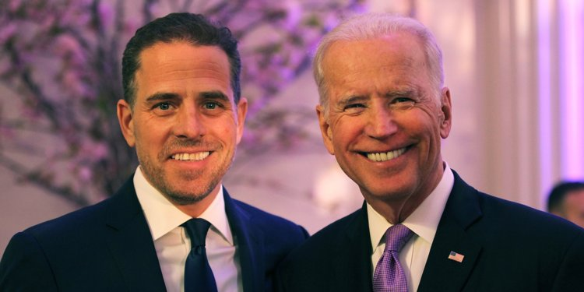
Joe Biden
Joe Biden is one of the major candidates to be the 2020 Democratic Nominee for President
While Biden was Vice-President from 2009-2017, his son Hunter was appointed to the board of a Ukrainian Energy Company that has recently been accused of wrongdoing
The United States gives Ukraine millions of dollars in aid each year, but the Trump administration unexpectedly decided to delay the 2019 payment of over $300 million with little explanation
President Trump hoped to make this a campaign issue in 2020 and wanted more information from Ukraine about it
He could use more info to smear Biden’s Presidential campaign and ruin his image among the electorate (voters)

Slide 6
Phone call With Ukraine’s President
President Trump had a phone conversation with the President of Ukraine on July 24, while he was withholding Ukraine’s $330 million payment
A whistleblower (someone that exposes wrongdoing) came forward with information about the phone conversation
The identify of the whistleblower is reported to be Michael Atkinson, the ICIG
ICGC = Intelligence Community Inspector General , appointed by President Trump in 2018
President Trump released the transcript of the phone conversation on Sep 25 (yesterday)
Link to view Transcript of the Phone Conversation
The whistleblower’s report was released this morning (Sep 26)
On the phone conversation, President Trump asked President Zelensky to investigate Biden son’s ties to the energy company 8 times
This could be viewed as treason
Congress is likely going to make a formal impeachment charge
President Zelensky of Ukraine

Slide 7
Journal #21
Should President Trump be impeached? Why or why not? Explain.

