Slide 1
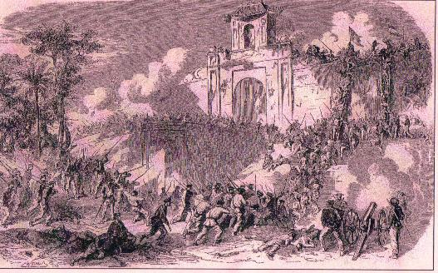
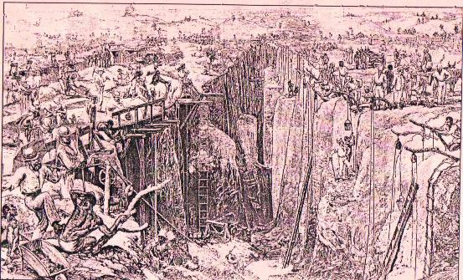
E.M.P.I.R.E (an acronym)
THE MOTIVES AND JUSTIFICATIONS FOR IMPERIALISM

Slide 2
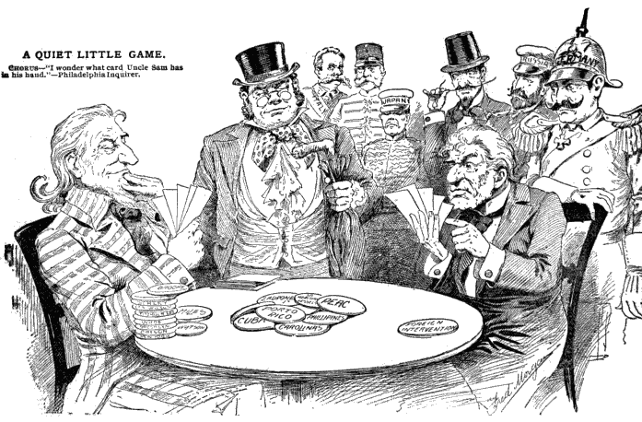
ECONOMIC MOTIVES
Imperialists were motivated to …
Make $$$!!!
They needed the factors of production (land/natural resources, workers, capital/new markets)

Slide 3
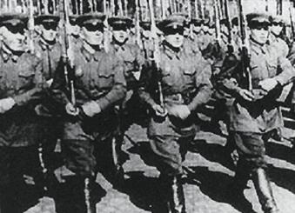
MILITARY MOTIVES
Imperialists justified imperialism by saying…
They needed to protect themselves from enemies and boost national security

Slide 4
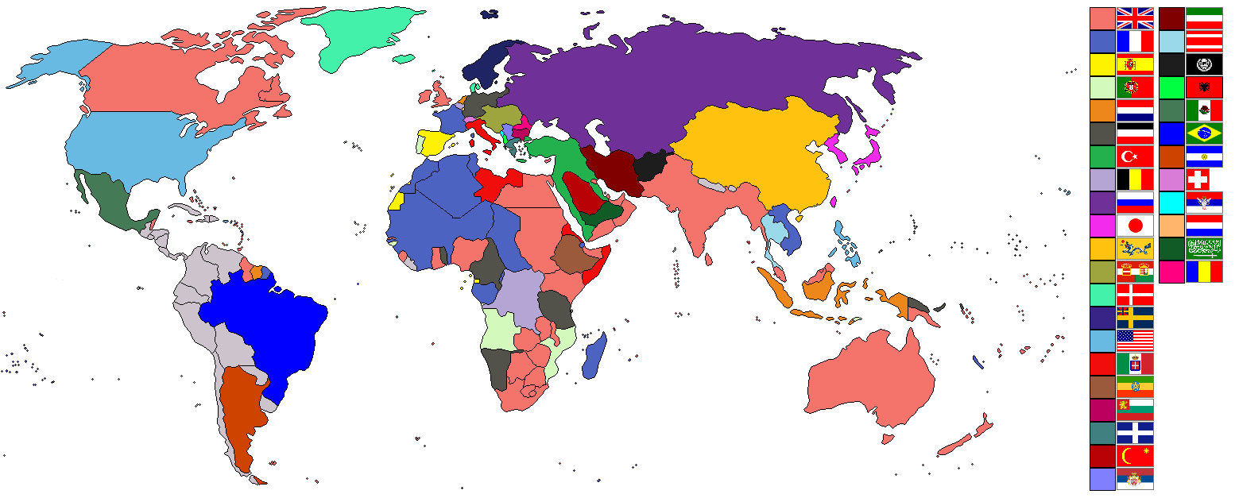
POLITICAL MOTIVES
Imperialists were motivated to…
Gain political power and compete with other countries by adding territory

Slide 5
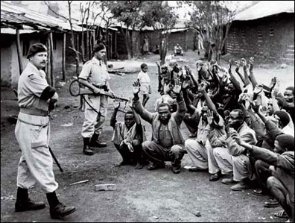
IDEOLOGICAL MOTIVES
Imperialists justified imperialism by saying…
Their culture and race were superior
They needed to “civilize” the “primitive cultures” in other countries

Slide 6
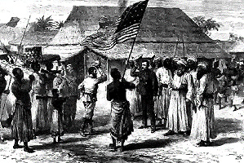
RELIGIOUS MOTIVES
Imperialists were motivated to…
Spread Christianity and their moral beliefs

Slide 7
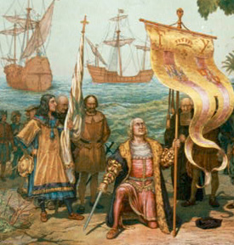
EXPLORATORY MOTIVES
Imperialists were motivated to…
Explore unknown and uncharted territory for scientific research and adventure

