Slide 1
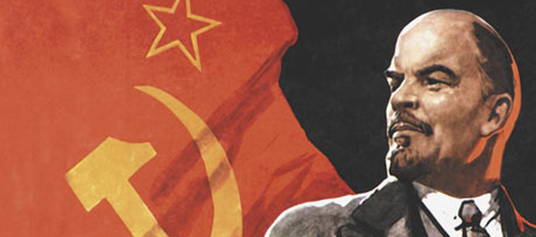
Russian Revolution in 1917

Slide 2
On your packet, write down three questions that you could ask the class to help them consider the significance of the image as it relates to the Russian Revolution

Slide 3
Group A: “Russia Under the Czars” and “The Beginnings of Unrest” Peasants

Slide 4
Peasants
Russia was slow to industrialize, so by 1900 about 80 percent of Russians were still rural peasants living in severe poverty. Although serfdom had been abolished in 1861, this did nothing to ease the poverty of most Russians. The poor conditions faced by the peasantry made them much more likely to support revolution.

Slide 5
Group B “Revolutionary Movements” and “The Last czars”
Czar Alexander II Assassination in 1881 by the People’s Will left-wing terrorist group

Slide 6
Czar Alexander II
Czar Alexander II was assassinated in 1881 by a left-wing terrorist group known as the People’s Will. This group came to believe that terrorist acts were the best way to force political reform and bring about the overthrow of the czarist autocracy. The czar was killed by a bomb thrown by a member of the People’s Will as he drove through the streets of St. Petersburg.

Slide 7
Group C “moving toward revolution”, “The rise of political Parties”, and “Marxism and Leninsm”
Vlandimir Lenin stands in front of a statue of Marx and Engels

Slide 8
Marx and Engels
The socialist philosophy of the Russian Social Democratic Workers’ Party was based on the ideas of the 19th century thinkers Karl Marx and Friedrich Engels. In 1903, a dispute over how to best apply Marxist ideas in Russia split the party into two factions. Lenin led the Bolshevik faction. Here Lenin speaks at an unveiling of a sculpture of Marx and Engels in 1918

Slide 9
Group D “The Revolution of 1905”, and “Reform, Repressions, and Continued Unrest”.
Bloody Sunday Massacre, January 22, 1905

Slide 10
Bloody Sunday
In 1905, Russian troops opened fire into a crowd of peaceful protesters in St. Petersburg, killing more than 100 people. The massacre came to be known as Bloody Sunday. This event, along with news of Russia’s defeat in the Russo- Japanese war, sparked the Revolution of 1905.

Slide 11
Group E “The Bolsheviks Take Control,” “The February Revolution,” and “Dual Power”
February Revolution

Slide 12
February Revolution
The demonstrations in Petrograd that began the February Revolutionwere sparked by female factory workers protesting bread shortages. Male workers, students, teachers, soldiers, and members of the middle class soon took to the streets as well. Here, demonstrators burn a portrait of the czar.

Slide 13
Group F “The October Revolution”
Bolshevik’s Take Control

Slide 14
October Revolution Bolsheviks Take Control of Petrograd Soviet
In September 1917, Bolsheviks gained control of the Petrograd Soviet. In October, they succeeded in overthrowing the Provisional Government. This is a painting of the meeting on October 26, 1917, in which the Bolshevik-dominated Soviet government installed Lenin as chairman.

Slide 15
Group G “Civil War”
Bolshevik Propaganda

Slide 16
Bolshevik Propaganda “Beat the Whites with the Red Wedge”
This Bolshevik propaganda poster from 1919 is entitled “Beat the Whites with the Red Wedge.” It uses the visual language of avant-garde modernism to convey a simple but powerful message about the Russian Civil War. In the poster, the red wedge symbolizes the Bolsheviks, who are penetrating and defeating their opponents, the Whites, during the Russian Civil War.

Slide 17
Group H “War, Communism, and the Red Terror” and “New Policies and New Leadership”
War Communism Policy results in food shortages

Slide 18
War Communism Policy
As part of Lenin’s War Communism policy, peasants were forced to provide food to the Red Army. The government also took charge of all food distribution. This resulted in severe food shortages. This 1919 image shows a starving woman collapsing on the street.

